Slide 1
Weekly Discovery Report 2
CycleSIGHT
Aiyana, Gloria, Farruh
Because pain isn’t one-size-fits-all.

Slide 2
CycleSIGHT
What is CycleSIGHT?
Our company
A clinical genomics laboratory that provides risk stratification panels for menstrual pain, medication safety(NSAID overuse complications), and underlying gynecologic conditions to enable earlier intervention and safer, more effective treatment selection.
Problem?
Many women rely heavily on NSAIDs like ibuprofen and naproxen for menstrual pain, often unaware that genetic differences can increase their risk of liver or kidney damage from repeated use. At the same time, chronic menstrual pain and conditions like endometriosis remain underdiagnosed and treated through trial and error.
How we want to solve this problem?
CycleSIGHT tackles both problems by identifying NSAID metabolism variants and hormone or pain-related genes to help clinicians guide safer, more personalized care.

Slide 3
CycleSIGHT
How CycleSIGHT works
Goal
Change and improve the standard of care for menstrual pain and endometriosis
Step 5
Clinician uses the diagnostic report to furthermore:
Guide referrals
Choose safer treatment options/methods
Justify further diagnostic tests
Step 4
CycleSIGHT issues clinical report that includes:
Risk stratification for pain treatments
Medication response insights
Clinical RECOMMENDATIONS*NOT DIAGNOSIS*
Step 3
CycleSIGHT analyzes targeted SNPs and genes related to:
Estrogen signaling
Inflammation and pain
NSAID metabolism
Step 2
Clinician orders the CycleSIGHT laboratory test
Blood or saliva sample
Sample then sent to CycleSIGHT’S CLIA-certified lab
Step 1
Patient presents clinician with symptoms
Poor response/ side effects to NSAIDS
Severe dysmenorrhea
Suspected endometriosis

Slide 4
CycleSIGHT
Questions we asked potential customers:
Do you think CycleSIGHT fills a unique gap in the healthcare market?
Would you be willing to pay between $65-$100 out of pocket (~$16-$51 with insurance) for this diagnostic test?
Would you be willing to participate in a subscription plan where you are tested annually for a re-interpretation of your genetic results?
Is $30/year with insurance ($45/year out of pocket) an acceptable price for an annual subscription to our services?

Slide 5
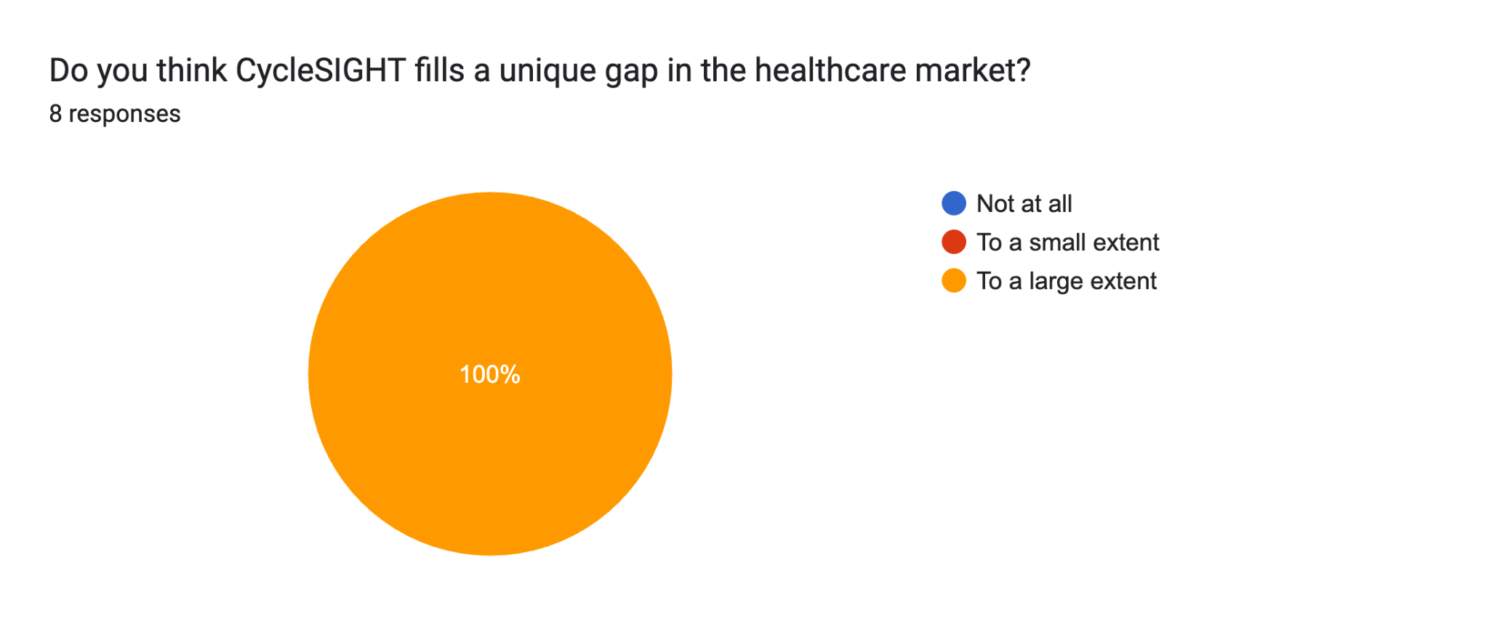

Slide 6
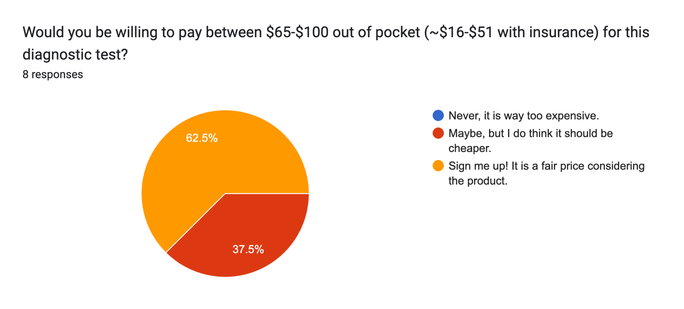

Slide 7
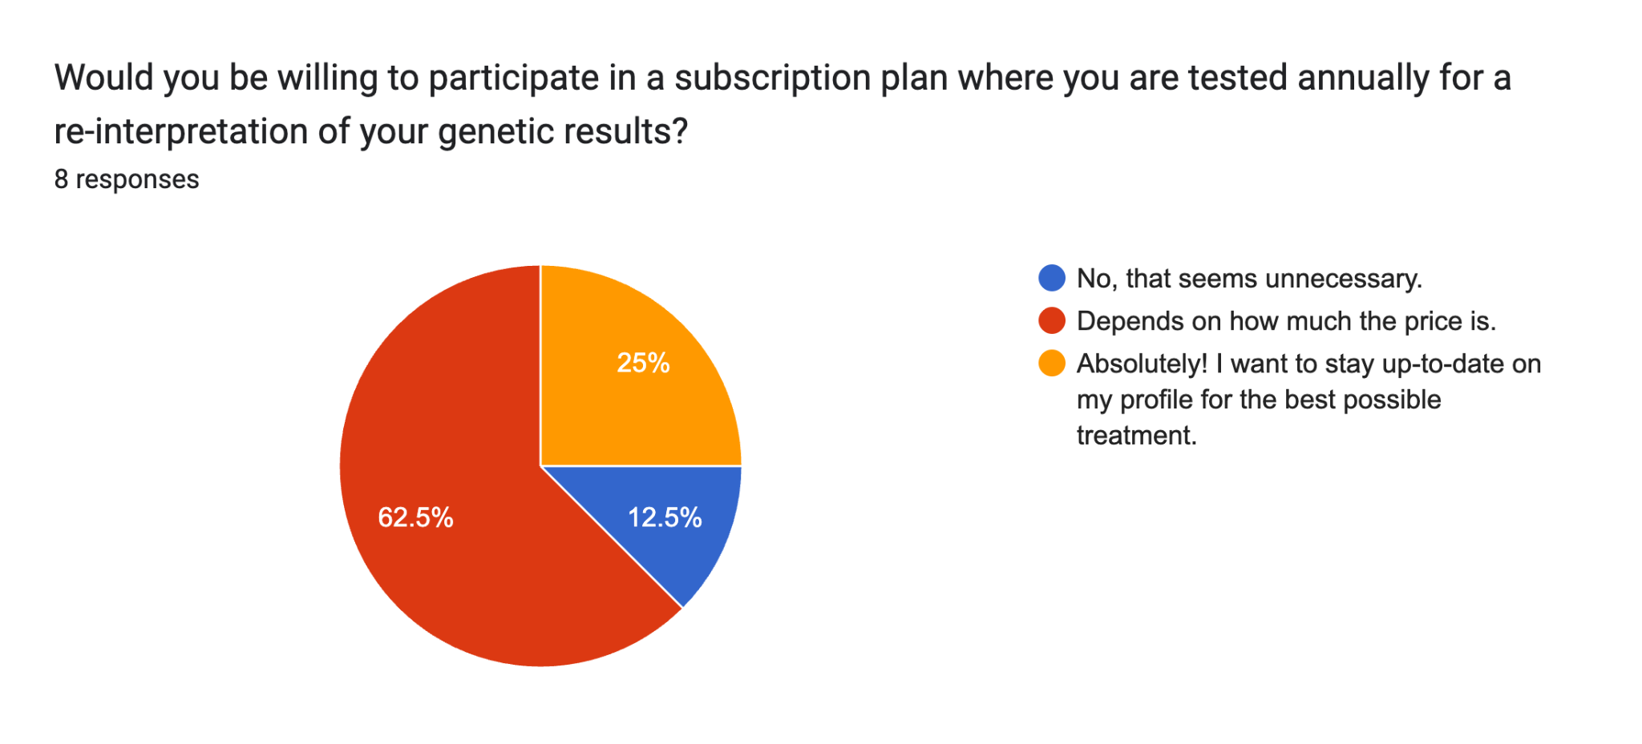

Slide 8
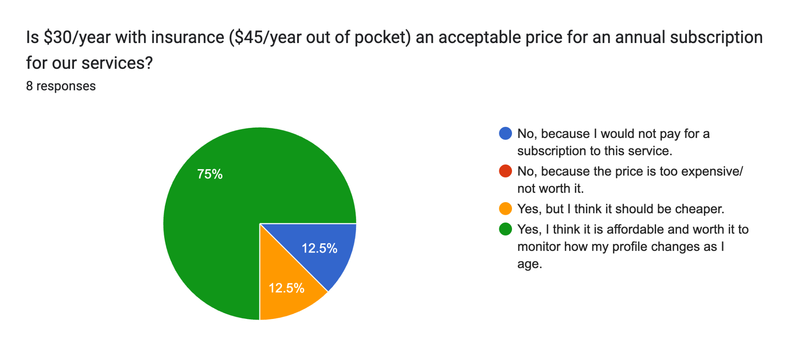

Slide 9
Thank you.

